Slide 1
Script Evaluation & Production Company Prediction
by
Arshiya Sayyada – as12855@nyu.edu Badhri Narayanan Suresh – bns332@nyu.edu Bhaskar Venkatraman – bv640@nyu.edu

Slide 2
“There is a wild oversupply of film productions—approximately 600 to 700 per year—while only 200 or so obtain even a decent release, permitting any return at all, much less a profit”
Forbes
Notes:
https://www.forbes.com/sites/schuylermoore/2019/01/03/most-films-lose-money/#7cc87ad1739f

Slide 3
Problem Statement
The film industry puts in billions of dollars into making movies every year but very few turn up a profit. Which scripts get selected to be made into movies is a very subjective process. It has more to do with luck than any logical thought process. They are operating on limited data.
Even if a script is great and it gets picked to be made, the wrong production company could squander its potential for profit.
We believe that for an industry with such a huge investment, there should be a more concrete and objective way of decision making.

Slide 4
Target Audience
Script writers with a bound script can narrow down the list of production companies for selling their script and eventually sell it to the company that has historically made great box office hits with similar scripts.
Production companies receive hundreds of scripts and therefore, take time to evaluate each of them. Prediction of expected rating and return by a system would expedite the process and eventually yield high efficiency.

Slide 5
Dataset
The files used contain metadata for all 45,000 movies listed in the Full MovieLens Dataset. The dataset consists of movies released on or before July 2017. Data points include cast, crew, plot keywords, budget, revenue, posters, release dates, languages, production companies, countries, TMDB vote counts and vote averages.
This dataset also has files containing 26 million ratings from 270,000 users for all 45,000 movies. Ratings are on a scale of 1-5 and have been obtained from the official GroupLens website.

Slide 6
Dataset
movies_metadata.csv
The main Movies Metadata file. Contains information on 45,000 movies featured in the Full MovieLens dataset. Features include posters, backdrops, budget, revenue, release dates, languages, production countries and companies.
ratings_small.csv
The subset of 100,000 ratings from 700 users on 45000 movies.

Slide 7
Architecture Diagram
4.5
DATA CLEANING
Rating Prediction
movies_metadata.csv
ratings_small.csv
RECOMMENDATION SYSTEM
6.78
Return/Profit Ratio Prediction
EXPLORATORY DATA ANALYSIS
List of Production Companies Prediction

Slide 8
Approach
Build a Recommender System solely based on plot line.
Provide list of Production companies that could most likely accept a movie script
Predict the revenue-budget ratio of movies taking as input its one-line plot.
Predict the Rating (IMDB) for unreleased movies

Slide 9
Data Cleaning
Drop duplicates and redundant columns : title vs original title, adult movies
Remove rows with incomplete data on revenue and budget
Remove entries with inconsistent datatypes: titles with ascii
Extract relevant information as new columns: return = revenue/budget, year from release date

Slide 10
Exploratory Data Analysis

Slide 11
Original Movie Languages
Number of Unique Languages : 91
Number of Movies in the Dataset : 45000
Number of English Movies : 32185
Majority of the movies released before 2017 have English as their original language.
About 71.5% of the movies are in English followed by French and so on.

Slide 12
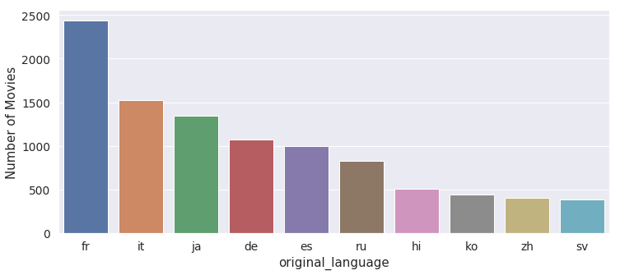
Movie Language Distribution (Excluding English)

Slide 13
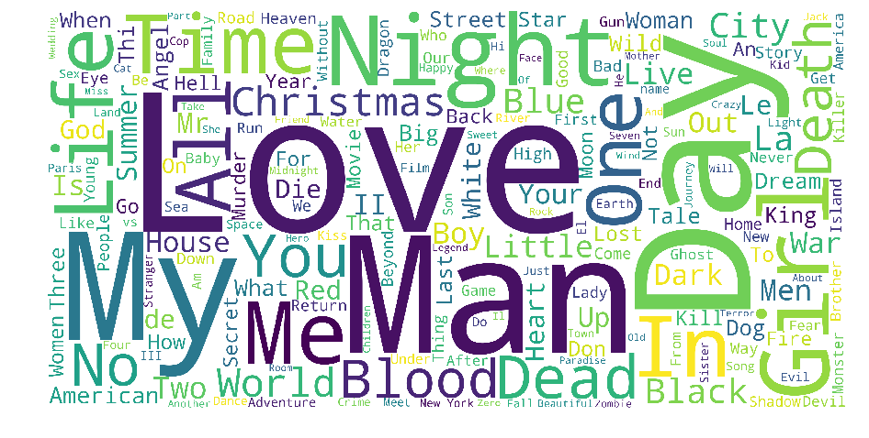
Movie Title - WordCloud

Slide 14

Movie Overview - Wordcloud

Slide 15
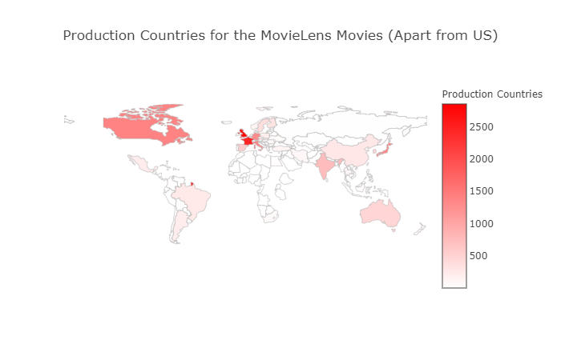
Production Countries - World Map Distribution
Notes:
Europe is also an extremely popular location with the UK, France, Germany and Italy in the top 5. Japan and India are the most popular Asian countries when it comes to movie production.

Slide 16
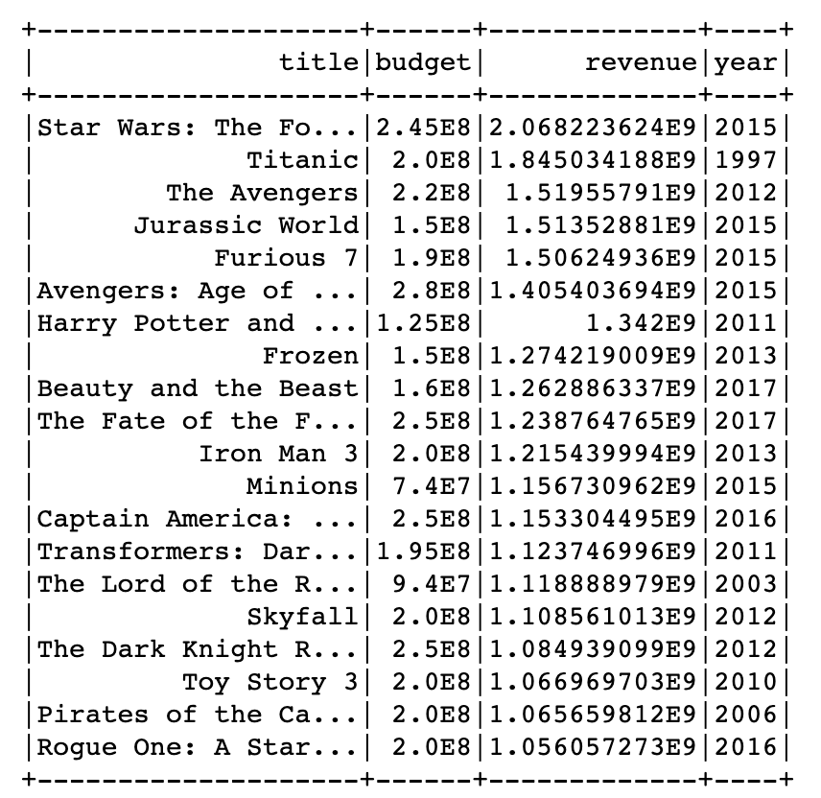
Highest Grossing Films of All Time

Slide 17
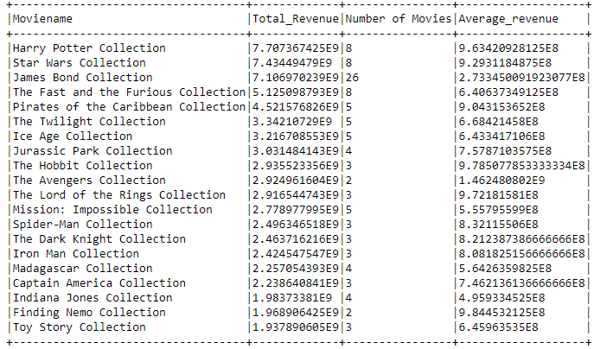
Movie Franchises - Highest Grossing Franchises

Slide 18
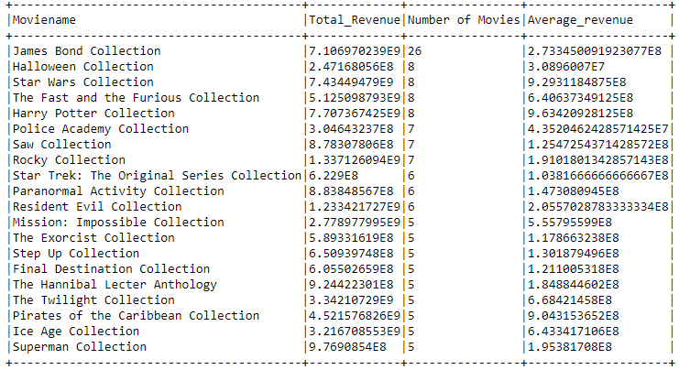
Movie Franchises - Longest Running Franchises

Slide 19
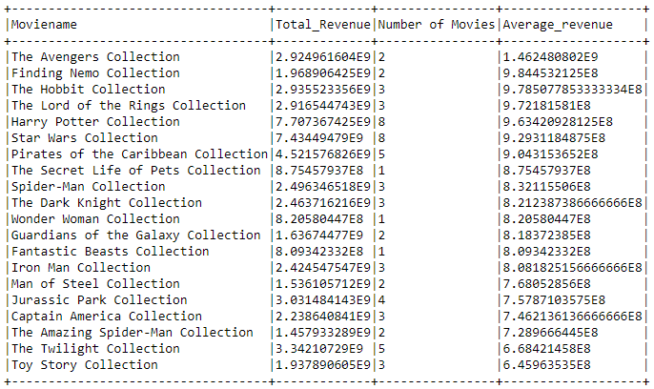
Movie Franchises - Most Successful Franchises

Slide 20
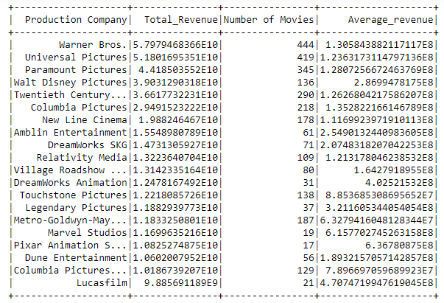
Production Companies - Highest Revenue

Slide 21
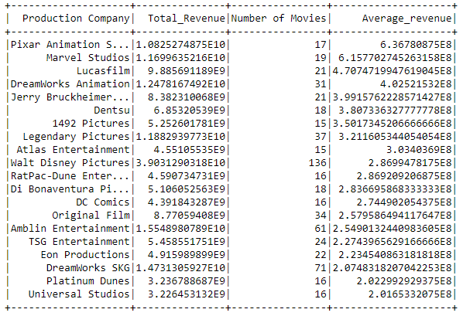
Production Companies - Most Successful

Slide 22
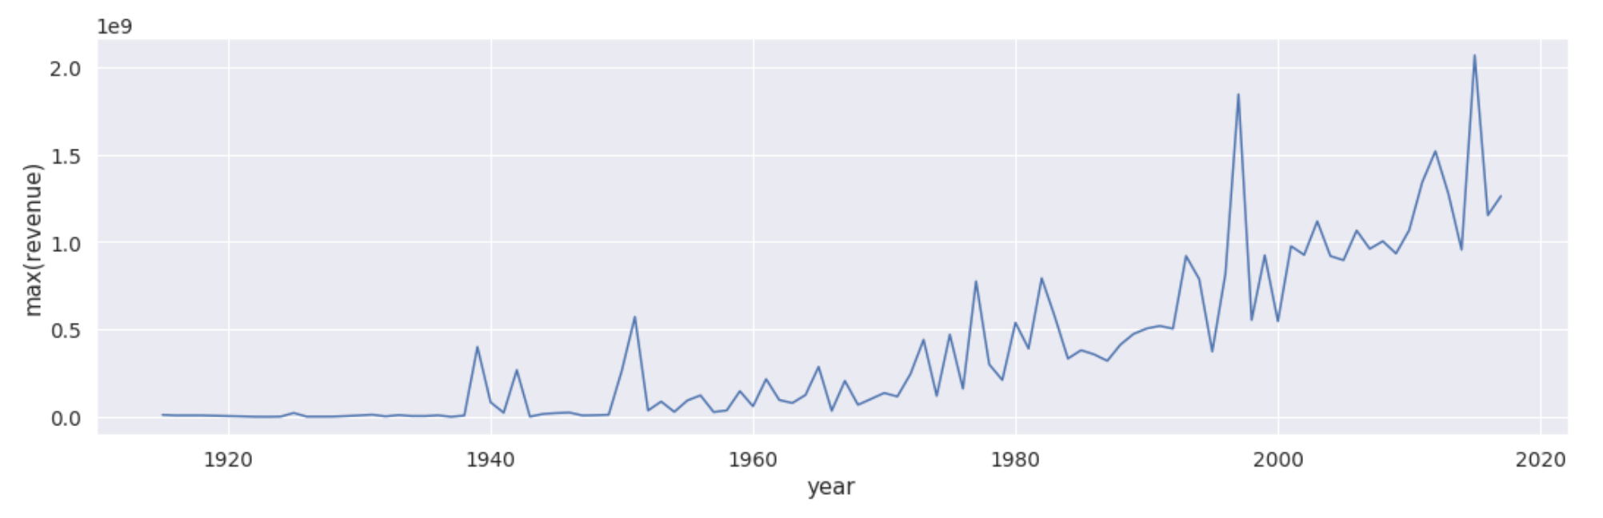
Maximum Revenue Through the Years

Slide 23
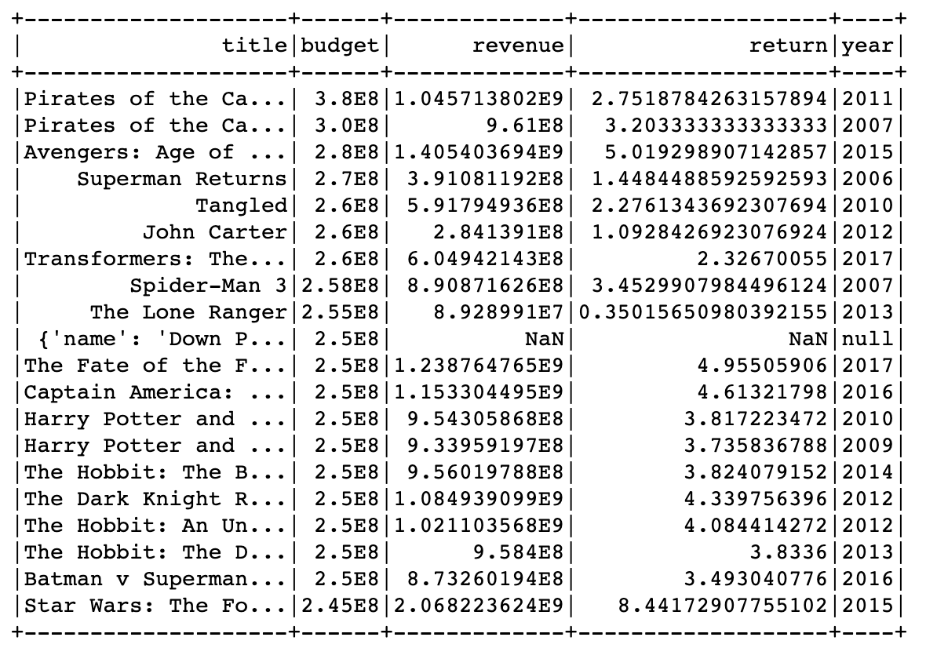
Most Expensive Movies of all Time

Slide 24
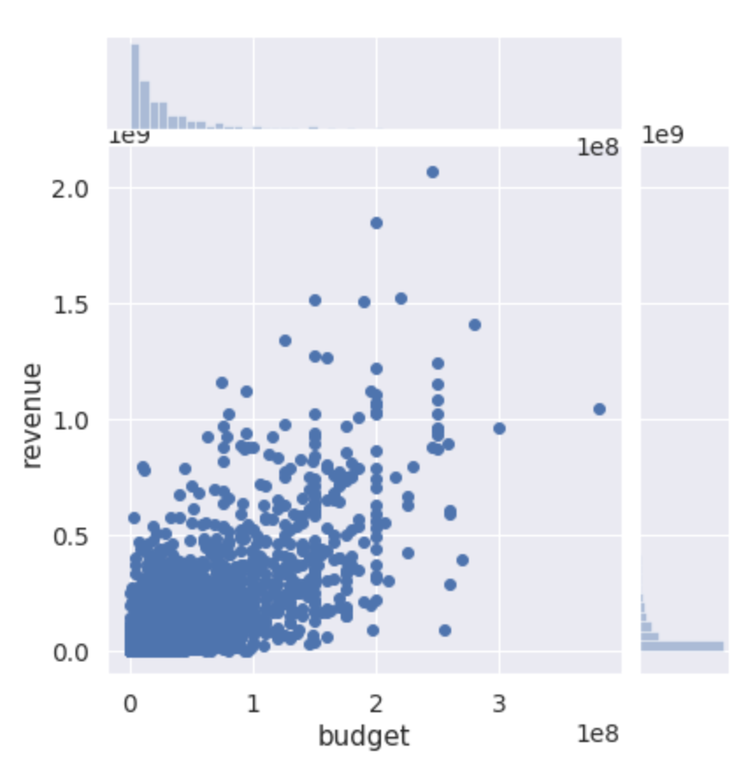
Returns or Movie Success Analysis
Return = Revenue/Budget
Notes:
There’s a strong correlation between revenue and budget. So one metric to determine a movie’s success would be return = revenue/budget

Slide 25
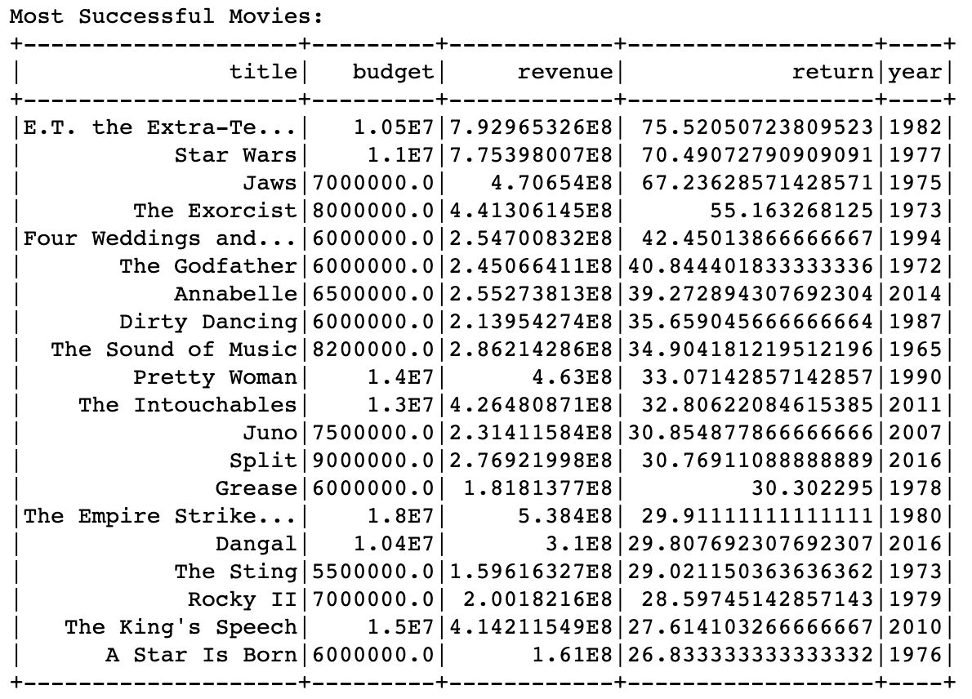
Most Successful Movies

Slide 26
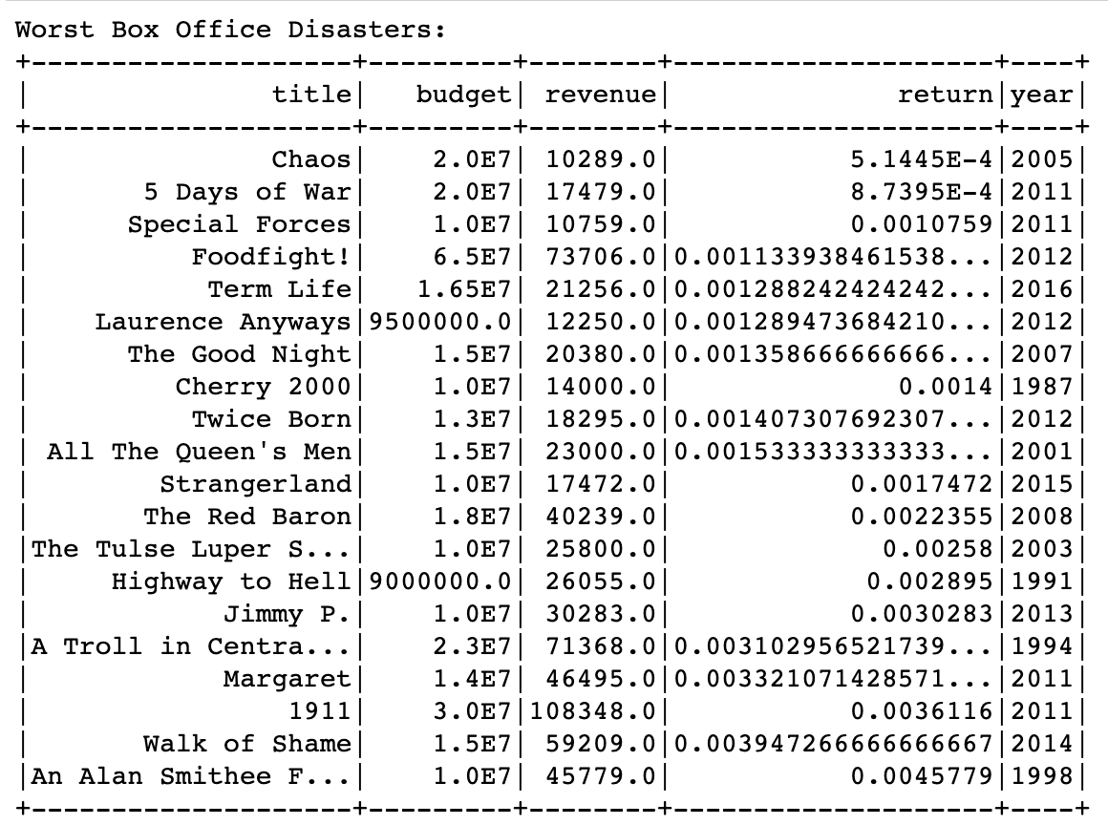
Worst Box Office Disasters

Slide 27
Description Based Recommendation

Slide 28
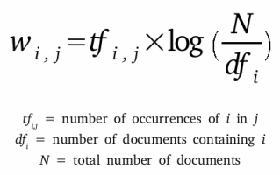
TF - IDF

Slide 29
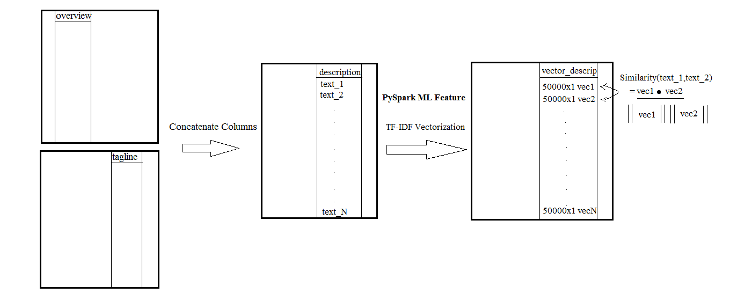
TF-IDF on Movie Description

Slide 30
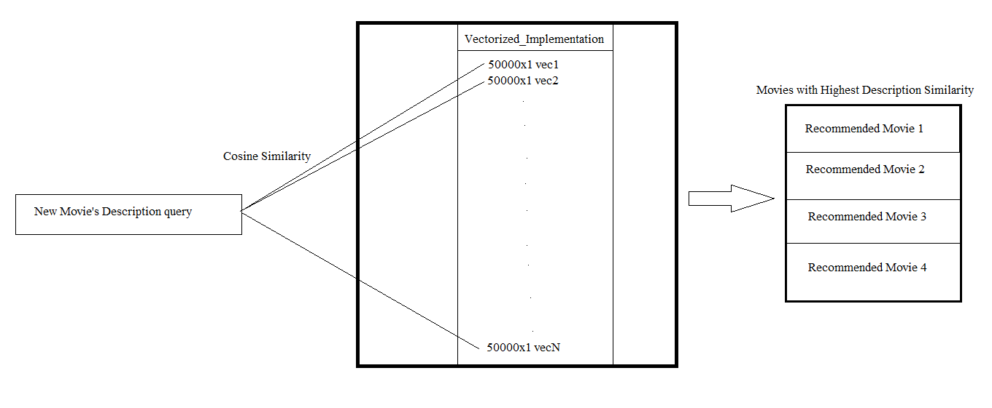
(Overview + genre)

Slide 31
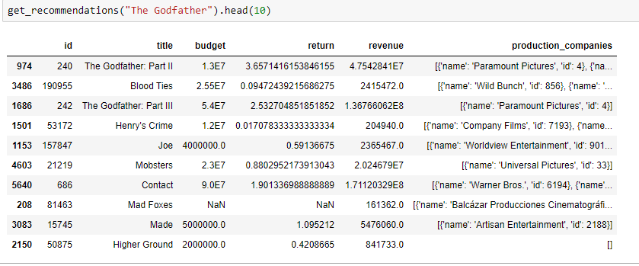
Recommendation - Example

Slide 32
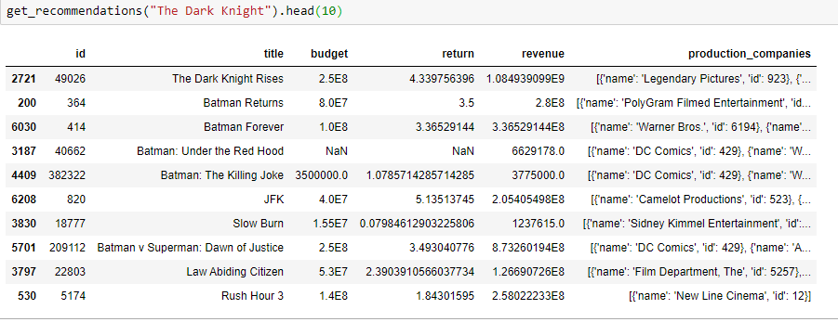
Recommendation - Example

Slide 33
Movie Plot Evaluation
For an input query description , we create a row in the dataframe and compute cosine similarity with each of the other movies description.
For top 10 similar movies, we compute average rating, average return ratio and a list of production companies that produced these films
Validation/Testing : Movies released after 2017

Slide 34
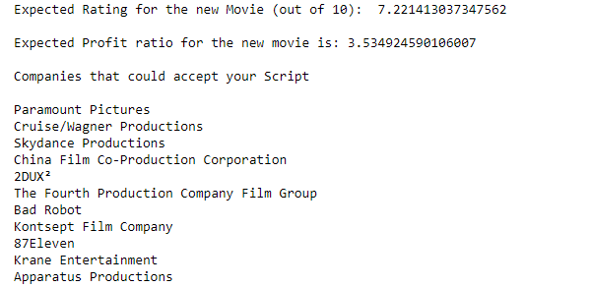
Examples - (a) Mission Impossible - Fallout (2018)

Slide 35
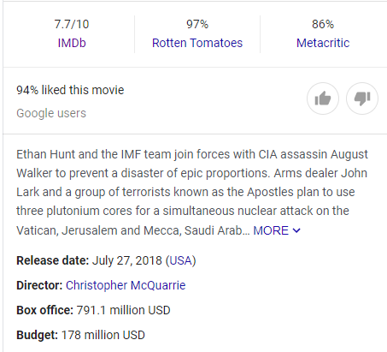
Return = 4.4

Slide 36
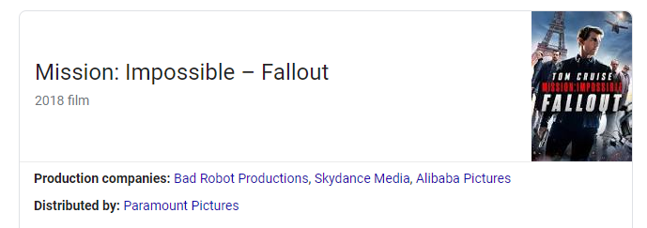

Slide 37
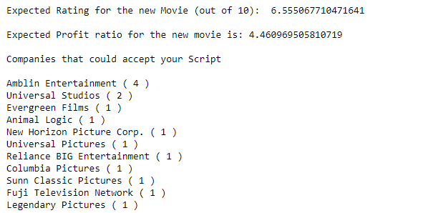
Examples - (b) Jurassic World : Fallen Kingdom

Slide 38
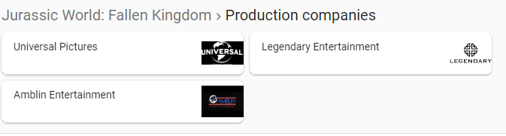

Slide 39


Slide 40
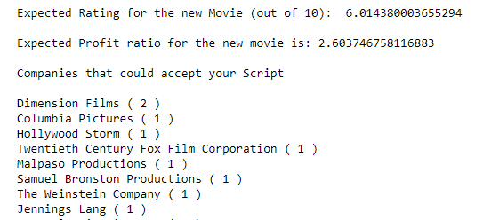
Examples - (c) Escape Room (2019)

Slide 41
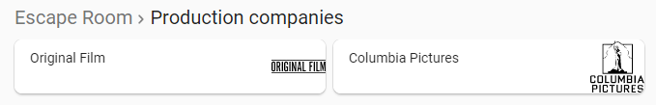

Slide 42


Slide 43
Future Improvements
Expanding the current description to more elaborate summary of movie to capture details of the plot.
Extend our analysis to predicting suitable cast and crew for a certain movie script

Slide 44
Thank you!

